Slide 1


micro:bit robot entry tutorial
Lesson 8
micro:bit advanced lesson 8 “Breathing lamp”
YahBoom micro:bit video tutorial

Slide 2
micro:bit robot entry tutorial
Content
Part1
Part 2
Part3
Part 4
Learning goals
Preparation
Search for blocks
Combine blocks
YahBoom micro:bit video tutorial

Slide 3
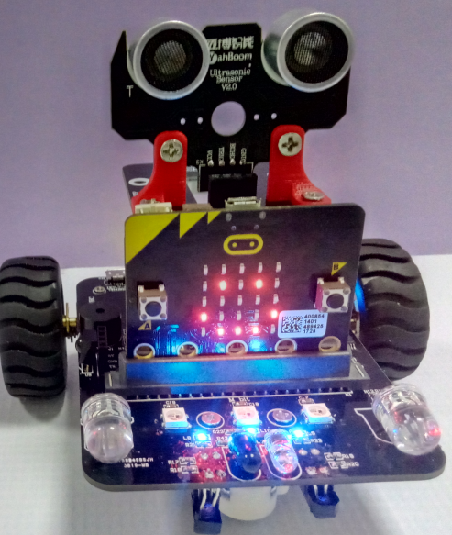
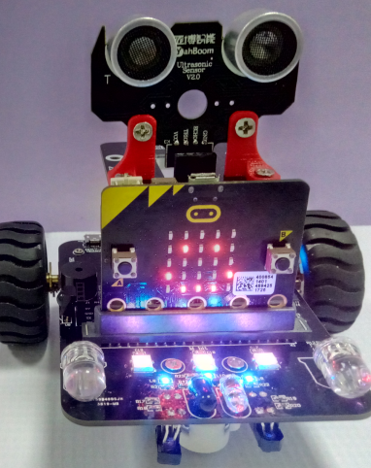
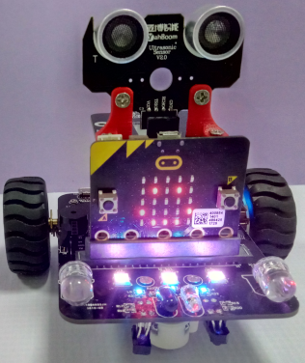
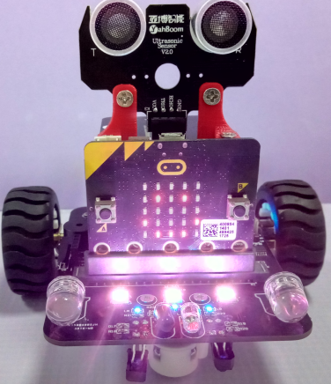
micro:bit robot entry tutorial
Part 1
Learning goals
After you download the program, you can see a smile on the dot matrix of the car, and the colorful lights fade slowly and brightly, and then fade away from the light. We can also change the color of the seven color lamp, which is very beautiful in the program. Let's take a look at the effect.
YahBoom micro:bit video tutorial

Slide 4
micro:bit robot entry tutorial
Part 2
Hardware:
● 1 X USB cable
● 1 X micro:bit robot
Preparation
Then the micro:bit is connected to the computer through USB, and the computer will pop up a U disk and click the URL in the U disk to enter the programming interface. Input this URL https://github.com/lzty634158/yahboom_mbit_en to get the package.
YahBoom micro:bit video tutorial

Slide 5
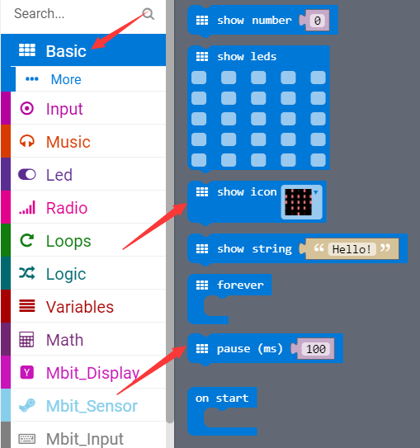
micro:bit robot entry tutorial
Part 3
Search for blocks
YahBoom micro:bit video tutorial

Slide 6
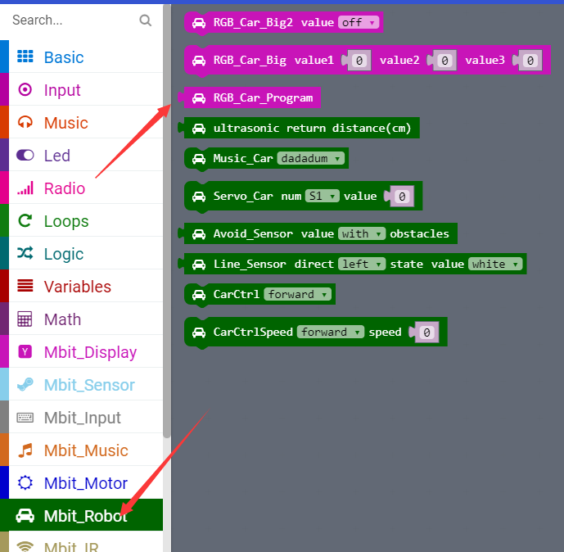
micro:bit robot entry tutorial
Part 3
Search for blocks
YahBoom micro:bit video tutorial

Slide 7
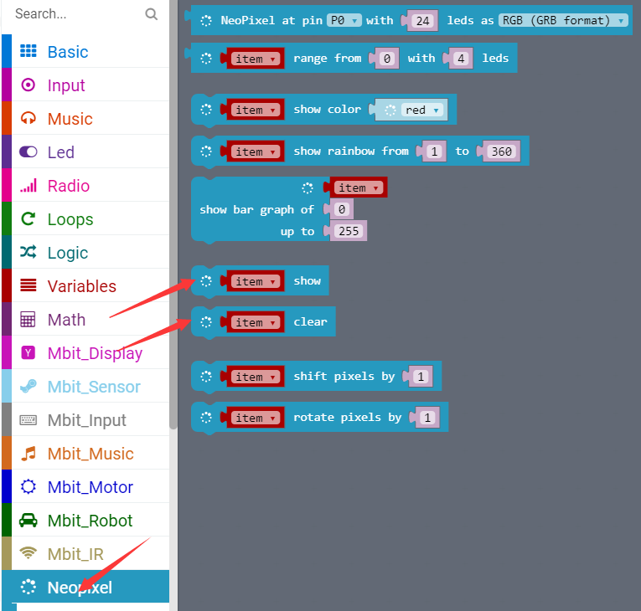
micro:bit robot entry tutorial
Part 3
Search for blocks
YahBoom micro:bit video tutorial

Slide 8
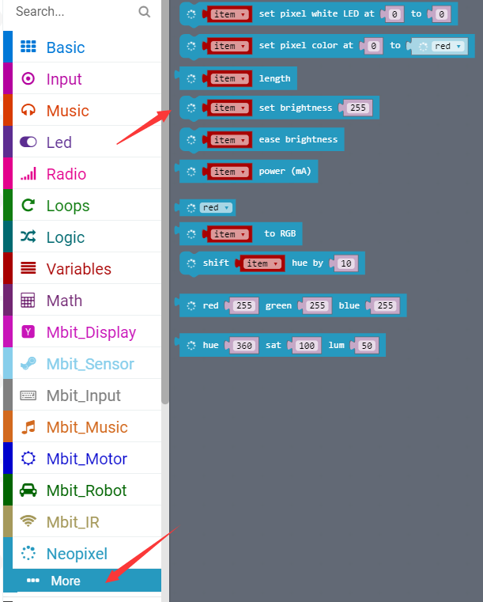
micro:bit robot entry tutorial
Part 3
Search for blocks
YahBoom micro:bit video tutorial

Slide 9
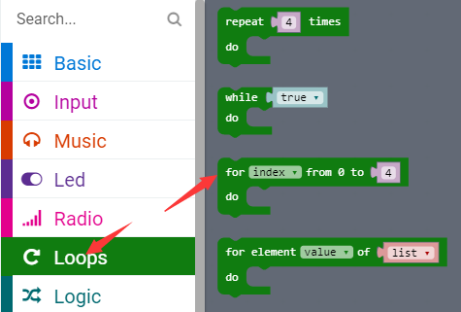
micro:bit robot entry tutorial
Part 3
Search for blocks
YahBoom micro:bit video tutorial

Slide 10
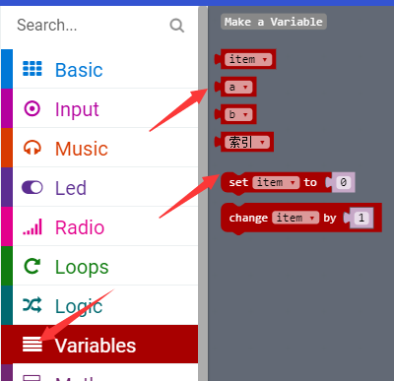
micro:bit robot entry tutorial
Part 3
Search for blocks
YahBoom micro:bit video tutorial

Slide 11
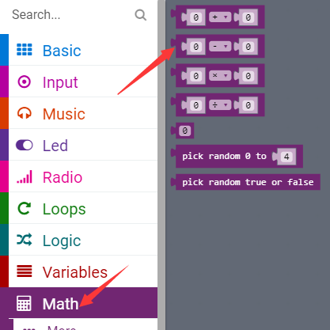
micro:bit robot entry tutorial
Part 3
Search for blocks
YahBoom micro:bit video tutorial

Slide 12
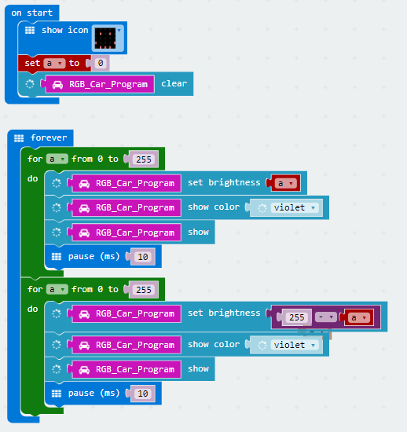
micro:bit robot entry tutorial
Part 4
The courses about water lamp need to turn off the power before downloading the new program, otherwise the water lantern will always be on.
Combine blocks
YahBoom micro:bit video tutorial

Slide 13
micro:bit robot entry tutorial
robot
lesson
Thanks for watching！
Powered by YahBoom
YahBoom micro:bit video tutorial

